Slide 1
The Yellow Áo Dài
Written by Hanh Bui
Illustrated by Minnie Phan
-A Classroom Companion-

Slide 2
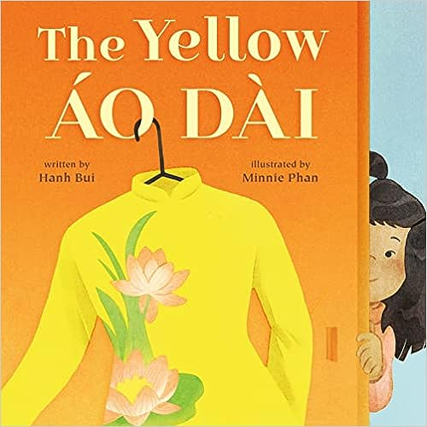
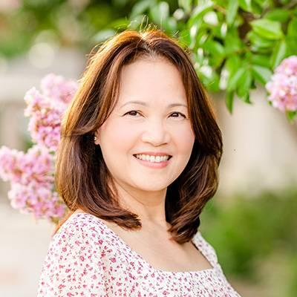
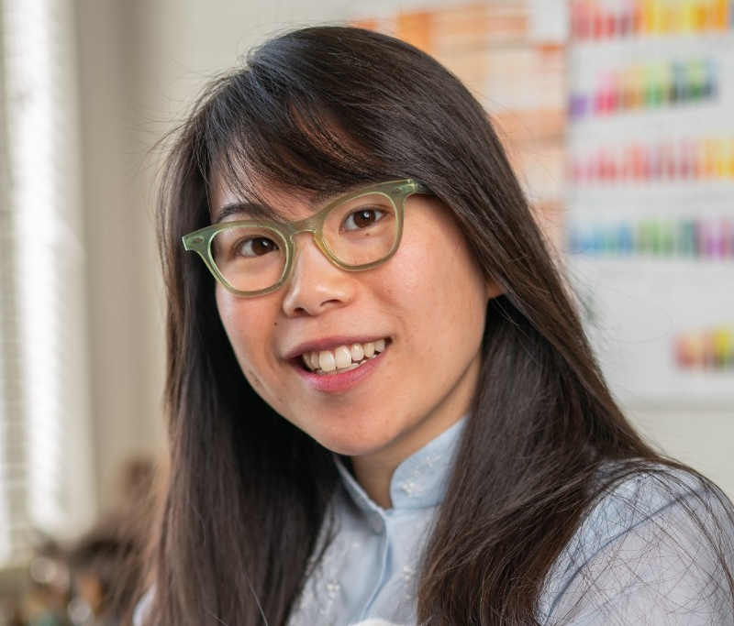
Images on this slide are clickable links!
Author: Hanh Bui
Illustrator: Minnie PHan
Purchase your copy today from:
Scrawl Books (click here and get an autographed copy)
Amazon.com
(click here)
Target.com
(click here)
Or order at your favorite Indie bookstore or request at your local library

Slide 3
A Note to Educators, Library Media Specialists and Parents
Thank you for choosing this Google Slide Deck to use with your students! The material can be used before, during and after you read The Yellow Áo Dài by Hanh Bui.
When you clicked on the link, you were prompted to create a copy of the slide deck. Before presenting to students, feel free to delete any slides that you don’t feel will be necessary for the content you will be teaching.
The material in this deck is directly aligned to the Common Core Learning Standards and the Virginia Department of Education (VDOE) Standards of Learning for English, with some alignment to New York’s NextGen Standards. In the cases of standards not applicable to your grade level, most can be found along the same strand (i.e., if a standard is listed as CCSS.ELA-LITERACY.RL.1.1, look to CCSS.ELA-LITERACY.RL.2.1 for alignment).
Please note: Slide Deck content copyright © 2023 by The Book Links LLC. Available free of charge for educational use only. All illustrations from the text were created by Minnie Phan. This deck may not be published or sold without express written permission.

Slide 4
Today’s Objectives
Today we will:
*Engage in a discussion with our classmates about the picture book The Yellow Áo Dài and analyze the significance of events in the story, evaluating character emotions and decisions as we read.
*Examine the role of identity in The Yellow Áo Dài and explore the Vietnamese culture.
*Identify how the characters demonstrate sustainability by reusing materials passed down through generations.
CCSS.ELA-LITERACY.RL.2.3 - Describe how characters in a story respond to major events and challenges.
CCSS.ELA-LITERACY.RL.2.7 - Use information gained from the illustrations and words in a print or digital text to demonstrate understanding of its characters, setting, or plot.
VDOE 2.7.d - The student will read and demonstrate comprehension of fictional texts - Describe characters, setting, and plot events in fiction and poetry

Slide 5
Identifying Text Features on the Book cover
Book Title
Illustrator
(The Creator of
Art Content)
Author
(The Creator of
Written Content)
CCSS.ELA-LITERACY.RL.K.6 - With prompting and support, name the author and illustrator of a story and define the role of each in telling the story.
VDOE K.8.a - Identify the role of an author and an illustrator.

Slide 6

Infer from the cover
What do you think this book will be about? What do you think an áo dài is?
What clues does the author give
you in the title?
What clues does the illustrator
give you in the cover art?
CCSS.ELA-LITERACY.RL.2.1 - Ask and answer such questions as who, what, where, when, why, and how to demonstrate understanding of key details in a text.
Next Gen 1R5: Identify a variety of genres and explain major differences between literary texts and informational texts. (RI&RL)
TEKS §110.3.b.6.B - Generate questions about text before, during, and after reading to deepen understanding and gain information with adult assistance;
VDOE 1.9a, 1.9b - The student will read and demonstrate comprehension of a variety of fictional texts - Preview the selection; Set a purpose for reading.

Slide 7

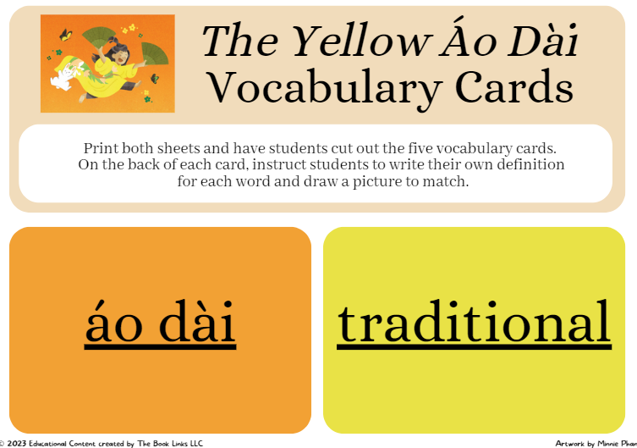
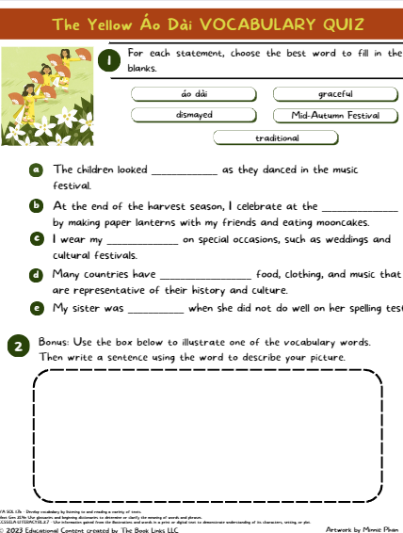
words to know and think about as we read
áo dài
(sounds like “now fly”)
traditional
Mid-Autumn Festival
graceful
Link to the PDF vocab cards
and vocab assessment:
dismayed
*Clicking on the BLUE words above will link to their dictionary definitions
Next Gen 2L4e: Use glossaries and beginning dictionaries to determine or clarify the meaning of words and phrases.
CCSS.ELA-LITERACY.RL.2.7 - Use information gained from the illustrations and words in a print or digital text to demonstrate understanding of its characters, setting, or plot.
VDOE 2.6 - The student will expand vocabulary and use of word meanings

Slide 8

Making Connections - TEXT TO SELF
THINK BEFORE WE READ!
(Whole class or partner share)
Think of a time when you made a mistake or you broke or
ripped something that belonged to someone else.
What were your choices on how to handle it? What reaction were you expecting the other person to have?
What did you ultimately decide to do? What did the other person say or do?
Next Gen 1R9: Make connections between self and text (texts and other people/ world). (RI&RL)
TEKS §110.2.b.5.E/§110.3.b.6.E - Make connections to personal experiences, ideas in other texts, and society with adult assistance;
VDOE 2.7.b - The student will read and demonstrate comprehension of fictional texts - Connect previous experiences to new texts.
Clip Art Credit: http://www.clker.com/cliparts/h/G/f/U/l/0/thinking-empty-thought-md.png

Slide 9
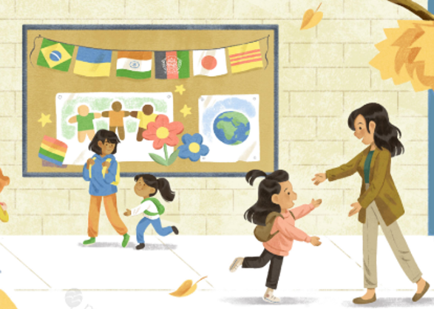
Understanding Story Context
At the start of the book, we learn that Naliah is going to be dancing a traditional Vietnamese dance on International Day, an event taking place at her school.
How does Naliah feel about dancing in the event? Why is the Fan Dance important to Naliah?
TALK ABOUT IT!
Is there a tradition in your family that you have shared with others?
CC.1.R.L.7 Integration of Knowledge and Ideas: Use illustrations and details in a story to describe its characters, setting, or events
CC.3.R.L.3 Key Ideas and Details: Describe characters in a story (e.g., their traits, motivations, or feelings) and explain how their actions contribute to the sequence of event
Next Gen 2R1: Develop and answer questions to demonstrate an understanding of key ideas and details in a text.
VDOE 2.7c - The student will read and demonstrate comprehension of fictional texts - ask and answer questions using the text for support.

Slide 10
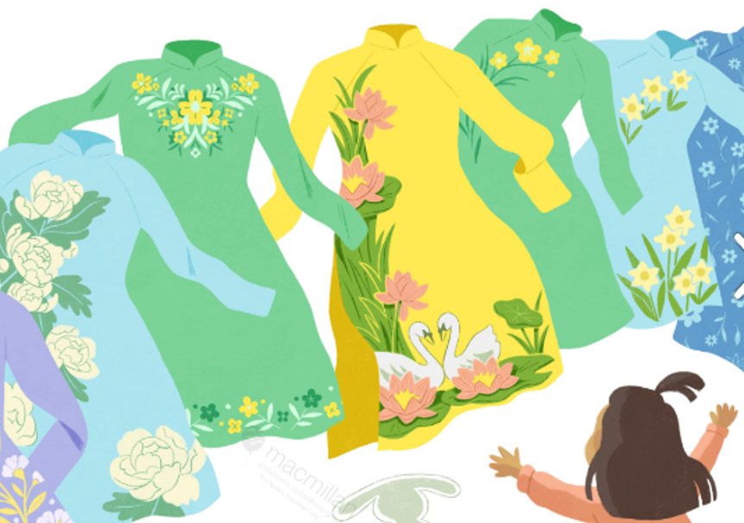
Questions to ask while we read
*How do you know Naliah’s áo dài is important to her?
*What is Naliah’s reaction when she enters her mother’s closet? What does Naliah do?
*What do you think is the significance of mom’s yellow áo dài? Why is Naliah drawn to it?
*
CCSS.ELA-LITERACY.RL.1.1 - Ask and answer questions about key details in a text.
CCSS.ELA-LITERACY.RL.1.9 - Compare and contrast the adventures and experiences of characters in stories.
CCSS.ELA-LITERACY.RL.2.1 - Ask and answer such questions as who, what, where, when, why, and how to demonstrate understanding of key details in a text
Next Gen 1R1: Develop and answer questions about key ideas and details in a text. (RI&RL)
Next Gen 2R3: In literary texts, describe how characters respond to major events and challenges. (RL)
VDOE 2.7c - The student will read and demonstrate comprehension of fictional texts - ask and answer questions using the text for support

Slide 11

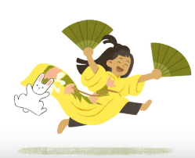
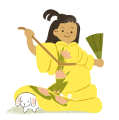
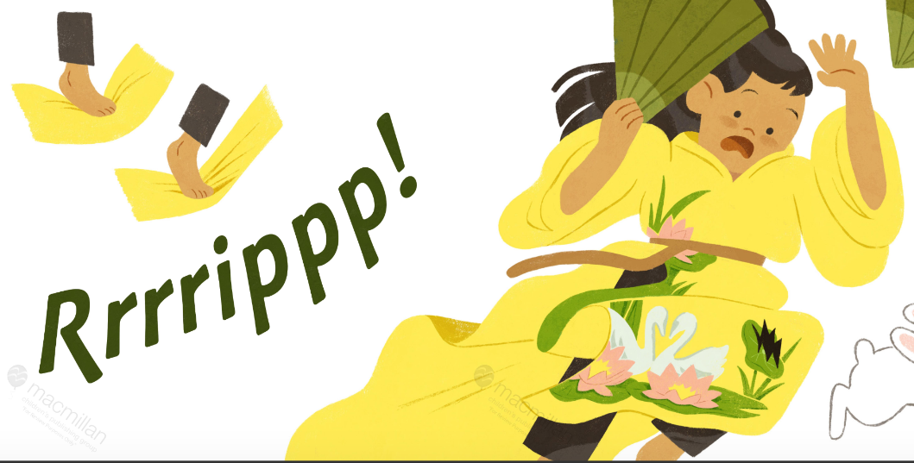
Make a Prediction
When Naliah tries on her mother’s yellow áo dài, she practices her fan dance but accidentally rips the dress.
What do you think Naliah will do? What would you do?
How do you think her mother will react?
CCSS.ELA-LITERACY.RL.2.1 - Ask and answer such questions as who, what, where, when, why, and how to demonstrate understanding of key details in a text..
NextGen 1R2: Identify a main topic or central idea in a text and retell important details.
NextGen 3R1: Develop and answer questions to locate relevant and specific details in a text to support an answer or inference. (RI&RL)
VDOE 2.7c - The student will read and demonstrate comprehension of fictional texts - ask and answer questions using the text for support

Slide 12
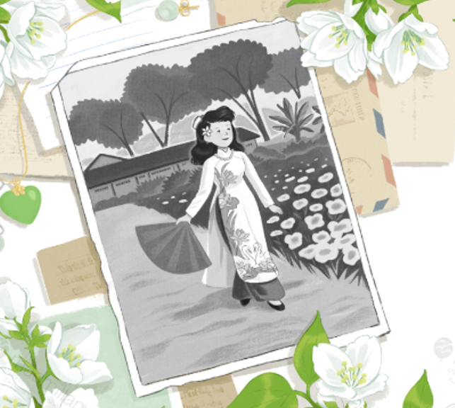
Identifying details
What details does the author tell us about the yellow
áo dài that Naliah accidentally ripped?
*How does the illustrator use details in her artwork to show the importance of the yellow áo dài?
CCSS.ELA-LITERACY.RL.K.7 - With prompting and support, describe the relationship between illustrations and the story in which they appear (e.g., what moment in a story an illustration depicts).
CCSS.ELA-LITERACY.RL.1.7 - Use illustrations and details in a story to describe its characters, setting, or events
Next Gen 1R4: Identify specific words that express feelings and senses.
TEKS §110.3.b.10.C - Discuss with adult assistance the author's use of print and graphic features to achieve specific purposes
VDOE 2.7c - The student will read and demonstrate comprehension of fictional texts - ask and answer questions using the text for support

Slide 13
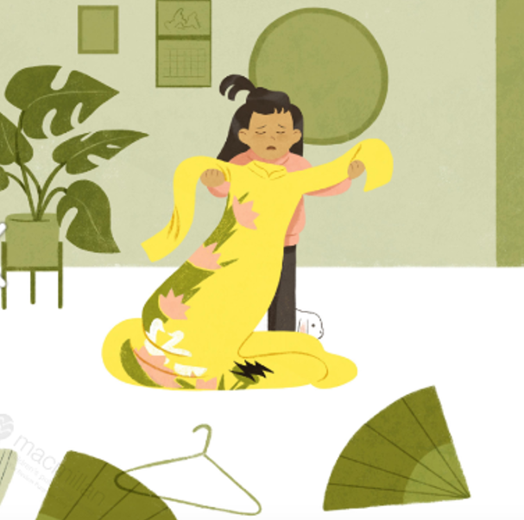
Evaluating Character Decisions
When mom goes looking for her yellow áo dài, Naliah apologizes and tells her mom that she accidentally ripped it.
What does this tell you about Naliah? What does this tell you about Naliah’s relationship with her mother?
CCSS.ELA-LITERACY.RL.3.1 - Ask and answer questions to demonstrate understanding of a text, referring explicitly to the text as the basis for the answers.
CC.3.R.L.3 Key Ideas and Details: Describe characters in a story (e.g., their traits, motivations, or feelings) and explain how their actions contribute to the sequence of event
Next Gen 2R4: Explain how words and phrases in a text suggest feelings and appeal to the senses.
VDOE 2.7c - The student will read and demonstrate comprehension of fictional texts - ask and answer questions using the text for support

Slide 14
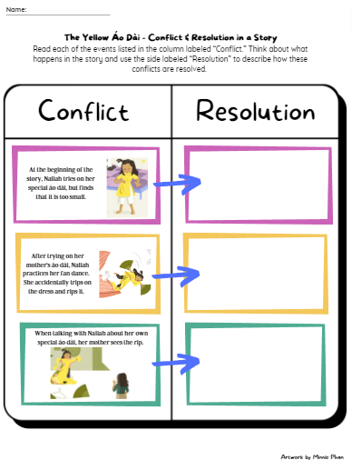
Let’s Talk about Conflict and Resolution
What is a conflict in a story? A conflict is…
What is a resolution in a story? A Resolution is…
Link to the PDF worksheet on Conflict and Resolution:
Now let’s think about what happens in The Yellow Áo Dài. Complete the worksheet to think about the events that occurred in the story, and specifically, how conflicts within and among characters were resolved.
CC.1.R.L.7 Integration of Knowledge and Ideas: Use illustrations and details in a story to describe its characters, setting, or events
CCSS.ELA-LITERACY.RL.2.7 - Use information gained from the illustrations and words in a print or digital text to demonstrate understanding of its characters, setting, or plot.
CC.3.R.L.3 Key Ideas and Details: Describe characters in a story (e.g., their traits, motivations, or feelings) and explain how their actions contribute to the sequence of event

Slide 15
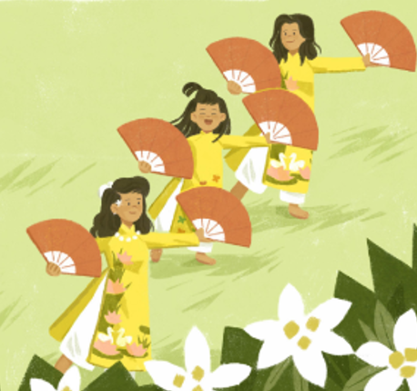
Understanding Plot
What do we learn about the connection among family generations in this story?
How can you relate this to your
own life?

Slide 16
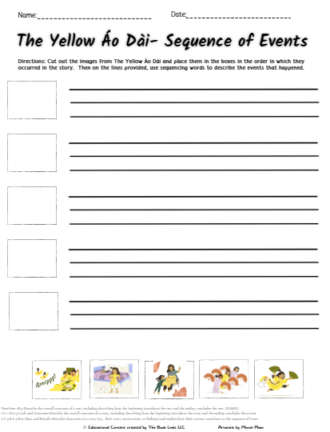
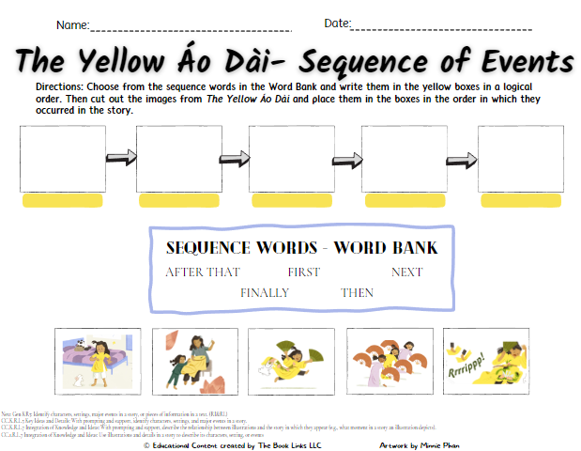
Let’s Sequence the events in the story
What are some of the words we use to describe the order in which events happen?
Sequencing Words We Know
Link to the PDF worksheets:
Now let’s think about what happens in the story The Yellow Áo Dài. Complete the sequencing worksheet to practice placing events from the story in the order in which they occurred.
CC.K.R.L.7 Integration of Knowledge and Ideas: With prompting and support, describe the relationship between illustrations and the story in which they appear (e.g., what moment in a story an illustration depicts).
NextGen: 2R5: Describe the overall structure of a text, including describing how the beginning introduces the text and the ending concludes the text. (RI&RL)
CC.2.R.L.5 Craft and Structure: Describe the overall structure of a story, including describing how the beginning introduces the story and the ending concludes the action
CC.3.R.L.3 Key Ideas and Details: Describe characters in a story (e.g., their traits, motivations, or feelings) and explain how their actions contribute to the sequence of event
VDOE 2.7g - The student will read and demonstrate comprehension of fictional texts - Summarize stories and events with beginning, middle, and end in the correct sequence.

Slide 17
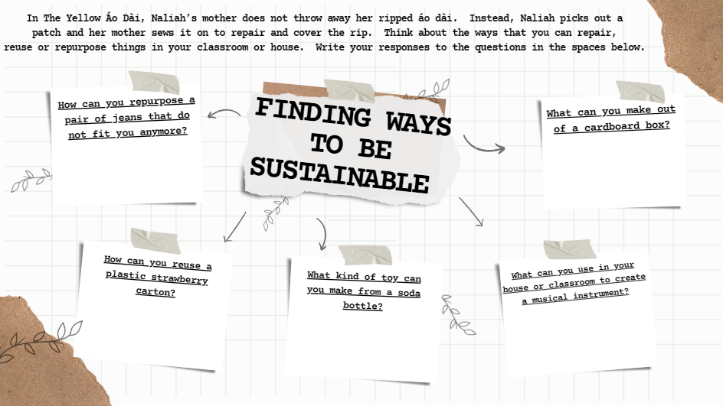
Closing
How does Naliah’s family demonstrate how something that is broken can be repaired instead of getting rid of it?
Think about a time when something special to you either ripped, broke or became too small for you.
What did you do with it? Why?
What ways can you repurpose something to use it again?
Link to the PDF worksheet
on Sustainability:
Next Gen 1W4: Create a response to a text, author, theme or personal experience
CCSS.ELA-LITERACY.RL.3.6 - Distinguish their own point of view from that of the narrator or those of the characters.

Slide 18

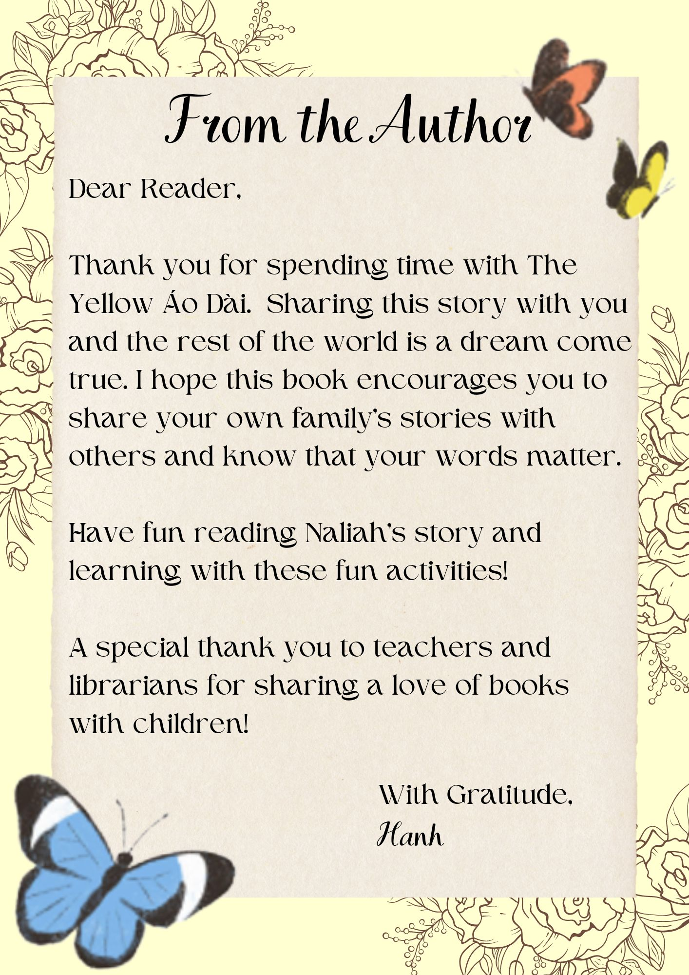
A MEssage from the Author

Slide 19
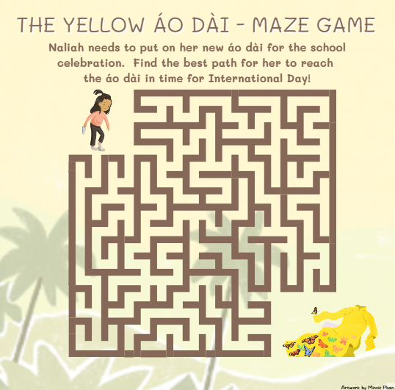
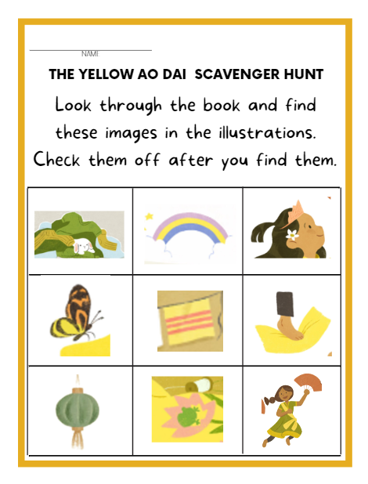
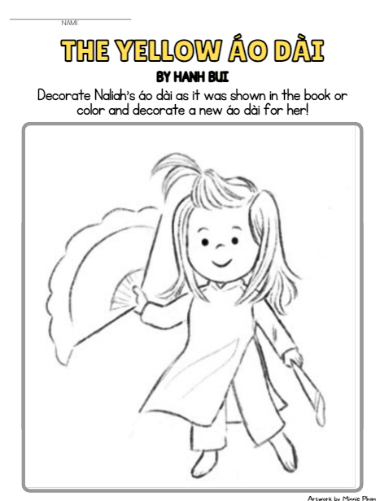
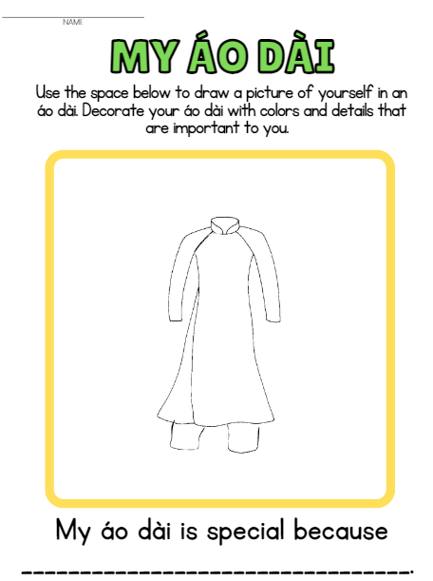
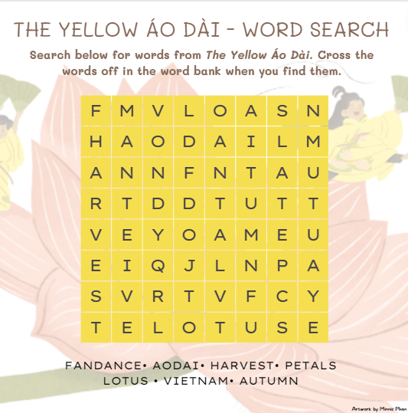
Let’s Have Fun!
After you read The Yellow Áo Dài, choose one of these activities for fun (Click on the images for the PDF versions):
Scavenger Hunt
Coloring Page
Drawing Page
Maze
Word
Search

Slide 20
Lesson Content Created by: Stephanie Fitzpatrick
Stephanie Fitzpatrick is an educator with sixteen years of experience in the NYC Department of Education and a passion for children’s books. She taught fifth and third grade and was an elementary assistant principal for ten years before becoming an educational consultant. She has a B.A. in History and Political Science from Binghamton University, an M.S.T. in Elementary Education from Pace University and an Ed.M. in Educational Administration from Teachers College Columbia University.
Please note: Slide Deck content copyright © 2022 by Stephanie Fitzpatrick. Available free of charge for educational use only. All illustrations from the text were created by Ana Sanfelippo and have been used with permission from the publisher. This deck may not be published or sold without express written permission. Contact Stephanie at thebooklinksllc@gmail.com
Slide Template follow permission guidelines of SlidesCarnival: www.slidescarnival.com/

